Slide 1
Smart Cars and Smart Highways, interconnected by a Central Computing Component
Johannes Brottrager, 1326320

Slide 2
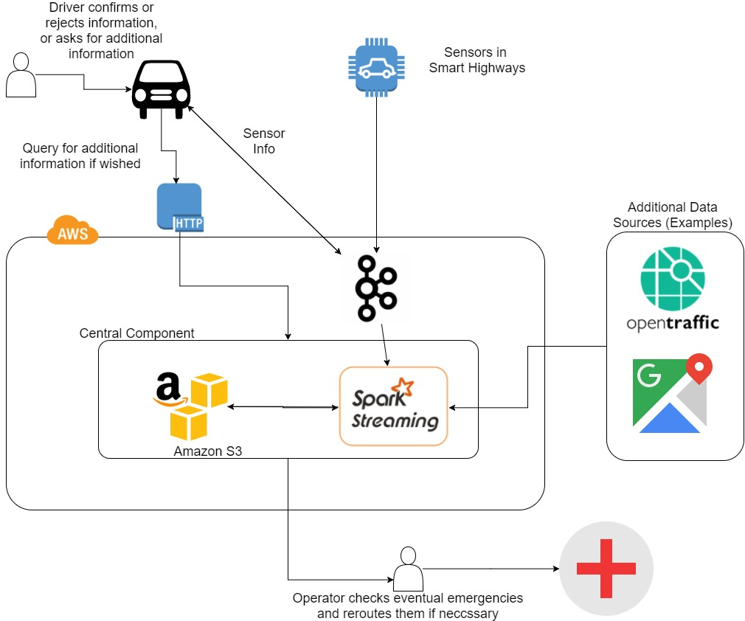

Slide 3
Implemented Prototype
Zookeeper and Kafka
Docker compose / aws ecs-cli compose
Webfrontend
Bidirectionally connected to kafka
Car packets can be posted and are sent to kafka
Publishes results from cluster
EMR Cluster with spark streamin war deployed
Large instances!
Sends results back to the webfrontend via kafka
Requester
Small program to help simulate requests

Slide 4
